Slide 1
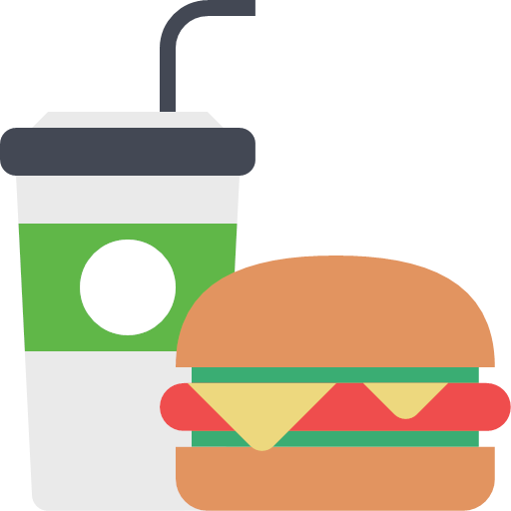
How to avoid the close-down of fast food restaurants?
Module 3–Group 11
Jiaqi Xia, Yutong Zhang, Midhun Satheesh

Slide 2
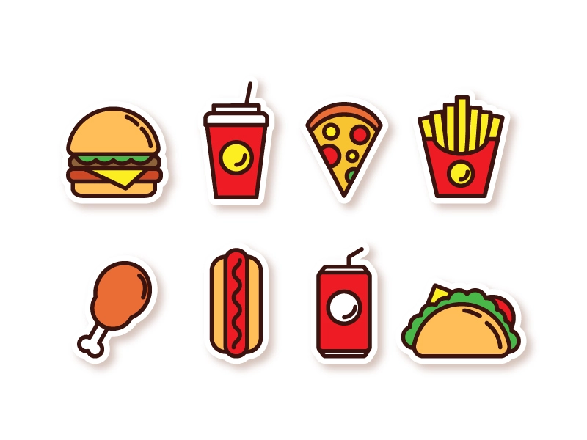
Goal&Outline
Attribute analysis
Review analysis
Recommendations
Shiny app

Slide 3
Attribute Analysis

Slide 4
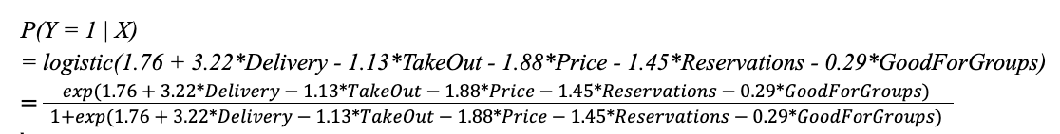
Logistic Regression Model
Status of Fast-Food Restaurant | Delivery | Take Out | Price Range | Reservations | Good For Groups
Open(low star ratings) = 1 Closed = 0 | Provide delivery service or not | Provide take out service or not | Price range from 1-2 | Accept reservation or not | Good for groups or not

Slide 5
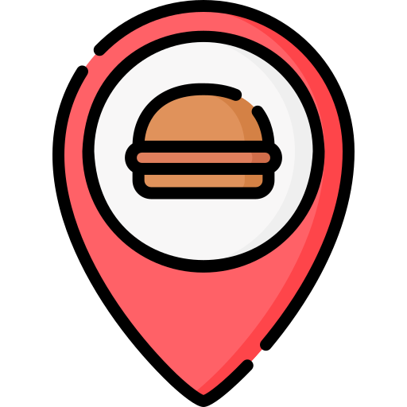
Interpretation & Prediction
Among fast food restaurants with identical selected attributes except delivery service, if the restaurant provides delivery service, the odds of avoiding close-down will increase by 25.03%.
The probability of remaining open for a fast food restaurant with delivery service, takeout service and the lowest price range is estimated to be about 87.7%.

Slide 6
Review Analysis

Slide 7

Review Cleaning
Convert text into words
Convert words abbreviation into full words (wasn't=was not, can't=can not)
Lowercase all reviews and remove numbers, punctuations and stopwords
Replace the negations with their synonyms (not worth = expensive, never disappointed=satisfied)
Split the words in reviews into positive and negative ones
idx | name | stars | positive | negative
2 | Hardee's | 1.78 | ['love', 'delicious'] | ['horrible', 'negative', 'bad', 'angry', 'negative', 'pathetic', 'with']

Slide 8
Sentiment Analysis
Select the top 6 fast food nouns by counting the words frequency
Define customer attitude score = # positive review of a food noun / # all review words of that food noun
Do a Chi-Square Test to see whether the six food nouns and customer attitude score are independent or not (p-value < 0.05).
name | pos_count | neg_count | attitude_score
cheese | 37196 | 9858 | 0.790
hot | 39944 | 10330 | 0.795
pizza | 16565 | 3347 | 0.832
salad | 32736 | 7674 | 0.810
taco | 18182 | 4901 | 0.788
burger | 27139 | 7487 | 0.784

Slide 9
Recommendations & Shiny App

Slide 10
Recommendations
Provide delivery service:
Why? If the fast food restaurant provides delivery service, the odds of avoiding closure will increase by 25.03%.
Introduce competitive pricing and great deals
Why? Food with a lower price range will improve 6.55 times the odds to let restaurants remain open.
Cancel the reservation needs
Why? Cancel the reservation will increase the probability of fast food restaurants remaining open by 4.26 times.
Provide more space for the people who come individually to follow the trend of the fast pace of modern society
Why? Fast food restaurants which suitable for eating alone tend to have a higher probability(95.67%) to remain open than Fast food restaurants which unsuitable for eating alone (94.31%).
Improve the quality and taste of burgers
Why? Burger has the lowest customer attitude score equal to 0.784 among the food menu.

Slide 11
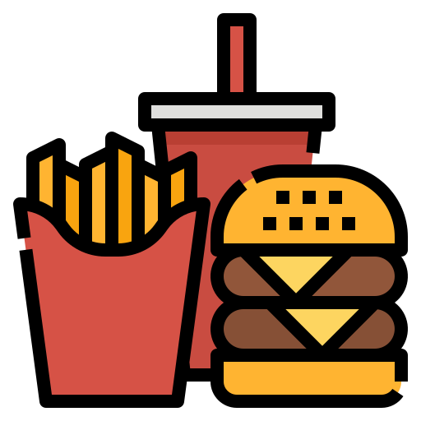
Limitations and Future Work
Since our recommendations are only based on the proportion of attributes, they are not comprehensive enough for fast food restaurants.
Our recommendations limit how to help a fast food restaurant avoid closure.
Introducing Aspect Based Sentiment Analysis (ASBA) and Natural Language Inference (NLI) models for a comprehensive study. Using advanced transformer bases NLP models like GPT-3

Slide 12
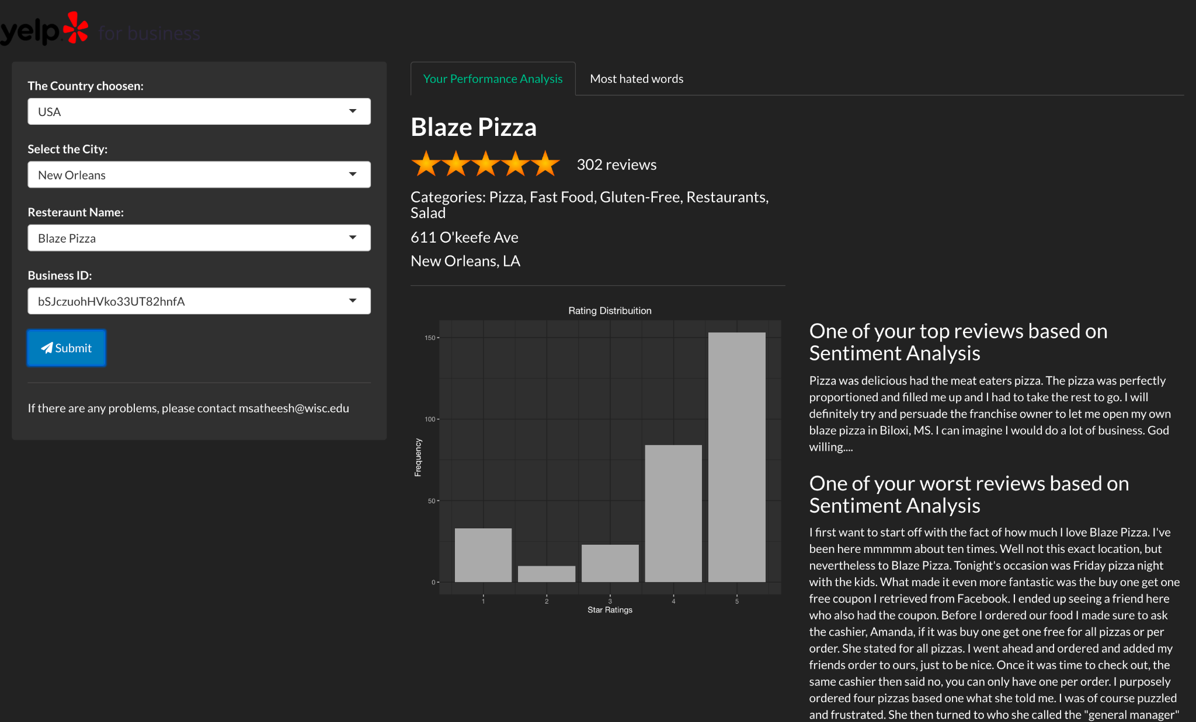
Shiny App
https://msatheesh.shinyapps.io/Module-3/

Slide 13
Thank you！

